Slide 1

https://www.facebook.com/tesseractspl
https://www.linkedin.com/company-beta/11222535/

Slide 2



Life Before Cloud Computing
Buy a stack of servers
Keeping the peak traffic in mind, buy more servers.
Monitoring and maintenance of your servers

Slide 3
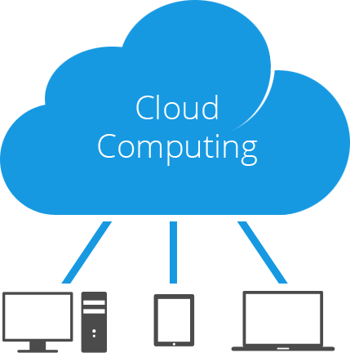
What is Cloud Computing?
Cloud computing is a method for delivering IT services like servers, databases, storage, networking services on the pay-as-you-go basis over the internet .

Slide 4
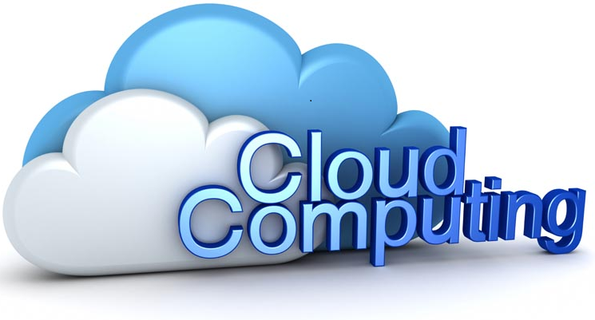

Why Cloud Computing?

Slide 5
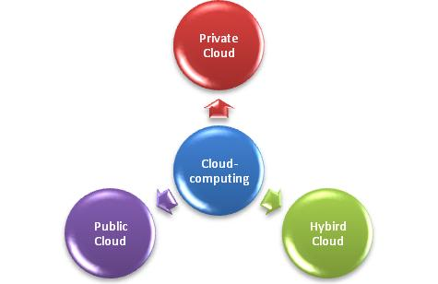
Cloud Types

Slide 6
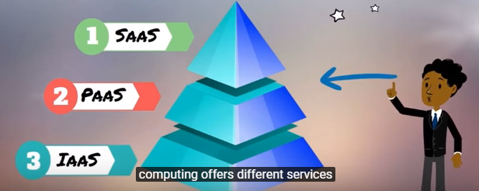
Cloud Services

Slide 7
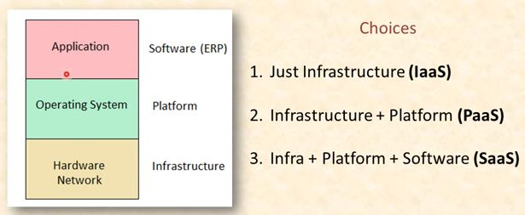
Cloud Services

Slide 8
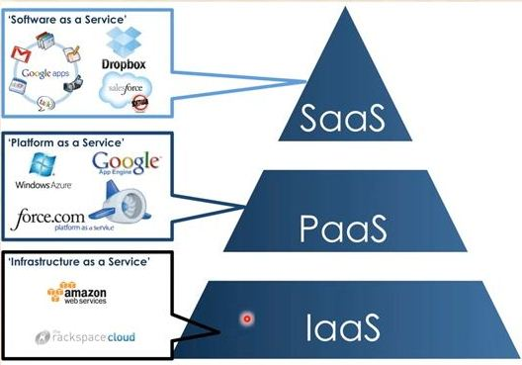
Cloud Services

Slide 9
Advantages of Cloud Computing
Cost
Ease of Scalability
Speed
Productivity
Performance
Reliability

Slide 10
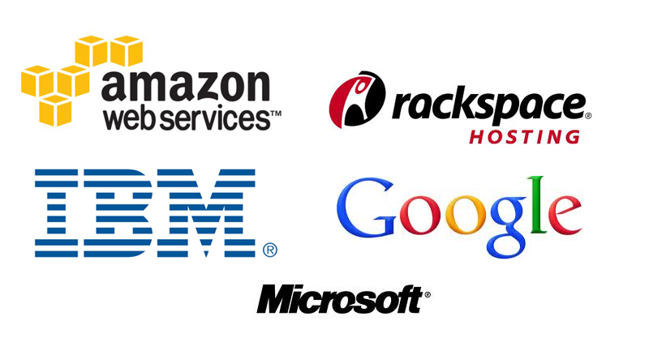
Some Cloud Service Providers

Slide 11


Slide 12


